Slide 1


Intro to Git and GitHub
Boston Code Camp 2018
Andrew Babiec
2018-04-07

Slide 2


Slide 3
What is Git?
Distributed Version Control System
Version Control System: track changes to source code: who, what, why, when

Slide 4



Centralized vs. Distributed
Centralized repository
Distributed repository

Slide 5
Git - Distributed Version Control System
Git Repository (repo/project)
Entire collection of files and folders, along with full history
Characteristics
Local & offline - Entire timeline/history of changes
Snapshots, not deltas
Changes are always additions
File history - snapshots in time called commits

Slide 6
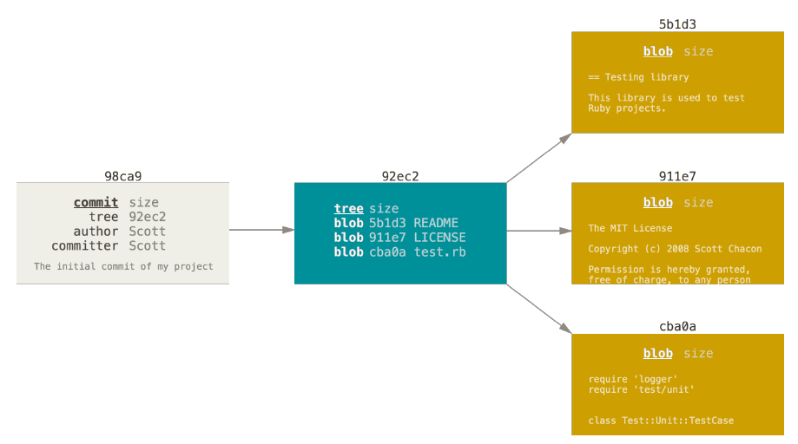
Git data structure – Commit, Tree, Blob

Slide 7
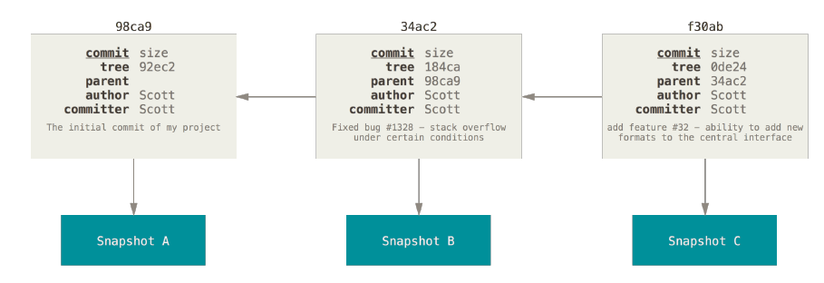
Commit linked-list relationship

Slide 8
Git Branches
Exist at the repository level
A branch applies to the entire repository
Unlike most centralized version control tools where branches exist inside the repository
Default branch is ‘Master’
Can be local or remote
Exceptionally lightweight
Implemented as a pointer to a commit in the graph
Exist only in the local repository until they’re explicitly shared
Encourages feature branching
Checkout – switch branch

Slide 9
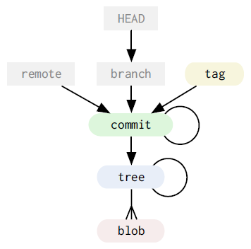
Git Data Model

Slide 10
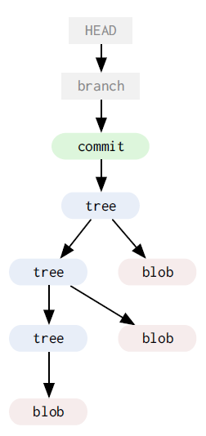

Slide 11
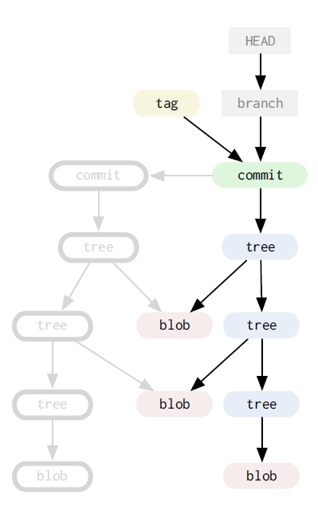

Slide 12
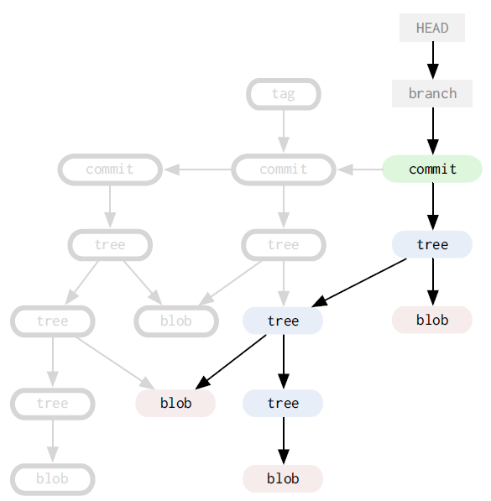

Slide 13
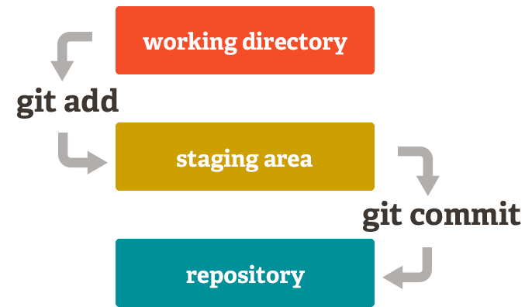
Git Two Stage Commit
Working/modified/workspace > Staging (index) > Committed/history/repo

Slide 14
Git File States
Files exist in 1 of 4 states
Untracked, Modified, Staged or Committed
An untracked file is one that is not currently part of the version controlled directory
Use git commands for adding, moving, renaming and removing/deleting files
git add
git mv (move and rename)
git rm (remove)

Slide 19
Git repo/project data
Git stores 3 copies of a project on your workstation.
One copy is your own repository with your own commit history.
The second copy is your working copy where you are editing and building.
State can be Working or Staged
The third copy is your local "cached" copy of a remote repository.
Git saves space by storing file contents as unique, compressed blobs identified by a hash

Slide 20
Git Remotes
Remotes - remote repository (internet or local network or local)
Origin - default name for remote cloned from
Merge Conflicts: local & remote
Commands
Fetch - get changes from remote, updates remote-tracking branch
Pull - combination of git fetch & git merge, updates current local branch
Push - push changes to remote

Slide 21
Git Commands
init, clone
add, mv, rm, reset, clean
checkout, commit
status, log, show, grep, reflog
branch, merge, diff, rebase, tag
fetch, pull, push
config, remote

Slide 22
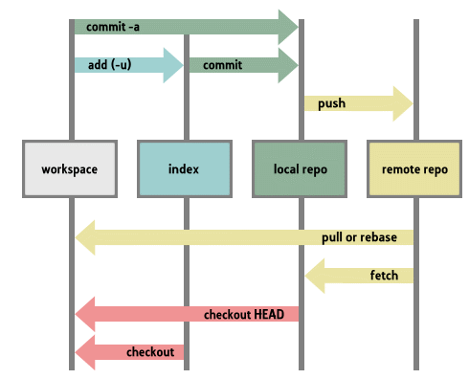

Slide 23
Git Workflows

Slide 24
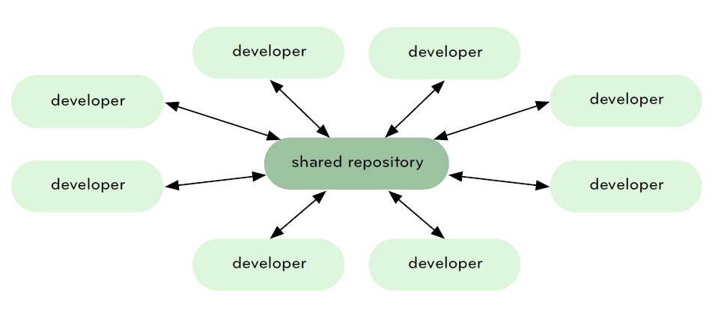
Central Repository

Slide 25
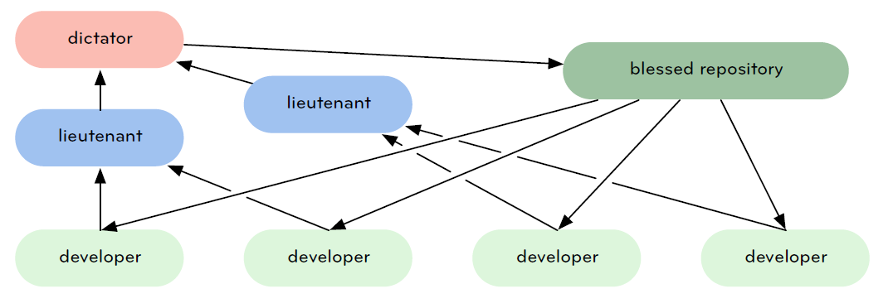
Dictator and Lieutenant Model

Slide 26
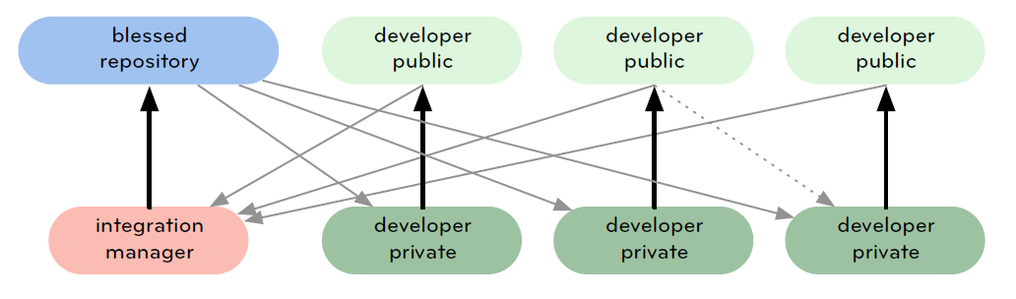
Integration Manager

Slide 27
Git terminology to know
head - symbolic reference to the branch you’re on. By default, there is a "head" in every repository called master.
HEAD - currently active head/branch
Tags - pointer to a commit (like a label)
Reset - rewrite history
Cherry-pick - pick up a specific commit
Rebase - reorder commits, edit them, squash multiple commits into one, etc.
Rebase vs. Merge (historical audit record vs. cleaned up record)

Slide 28
Git Rebase warning:
Do not rebase commits that exist outside your repository.

Slide 29
GitHub

Slide 30
Github
Online Service/Collaboration Platform
Core function is an online git service
Adds: issues, pull requests, code review, orgs & teams, pages, etc.
Enhancements on top of Git
Fork - copy of another repository (clone)
Pull Request (PR) – code review & approval step
Github Flow
Create Branch, Add Commits, Open PR, Discuss & Review, Merge & Deploy

Slide 31
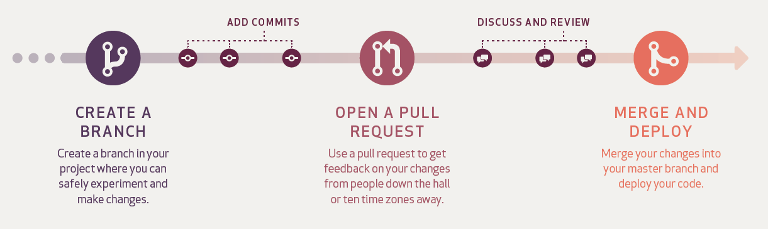
GitHub Flow

Slide 32
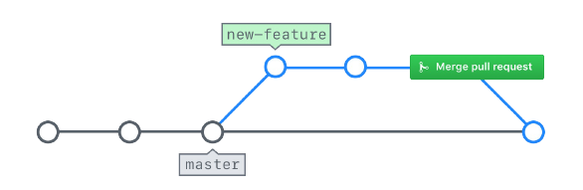
Github Branches and PR Merging

